Slide 1
Quantum Computing
By Sydney G. and Madelyn G.

Slide 2
Overview
Title and Subtitle
Overview
History
Plan and Implementation
Upsides/Pros to
Downsides/Cons to
Summary
References

Slide 3
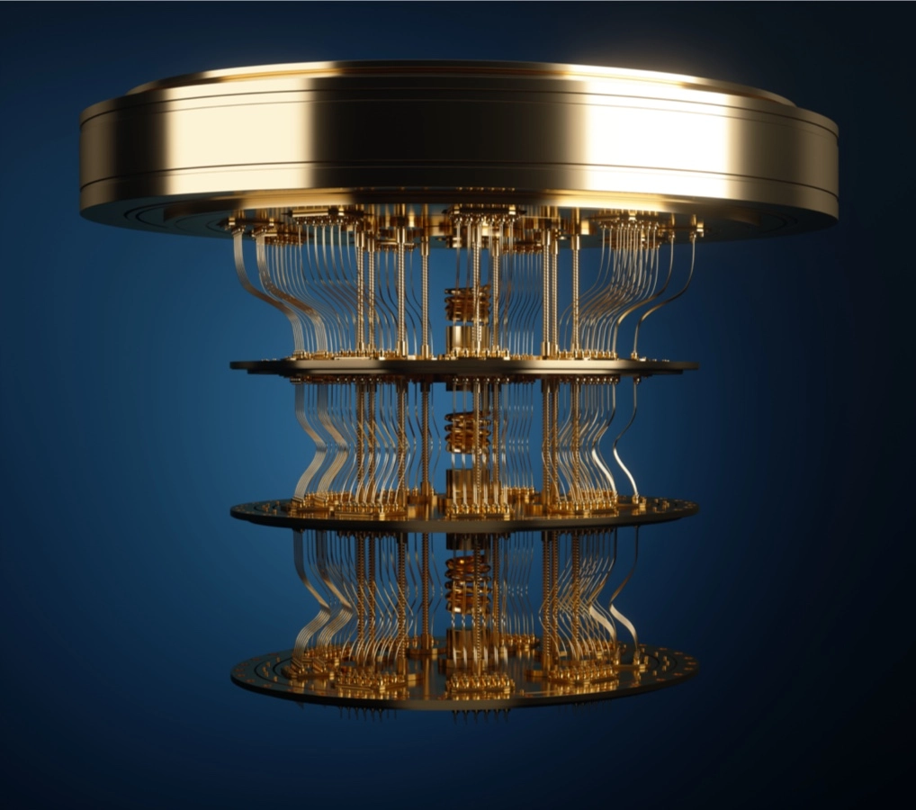
History
See this timeline of quantum computing: Quantum Computing Timeline
Who: Richard Feynman
When: 1982
Notes:
Quantum computing is a rapidly-emerging technology that harnesses the laws of quantum mechanics to solve problems too complex for classical computers.
Today, there’s real quantum hardware - a tool scientists only began to imagine three decades ago - available to hundreds of thousands of developers.
Richard Feynman first introduced the idea of quantum computing in 1982 in a talk titled “Simulating Physics With Computers”.

Slide 4
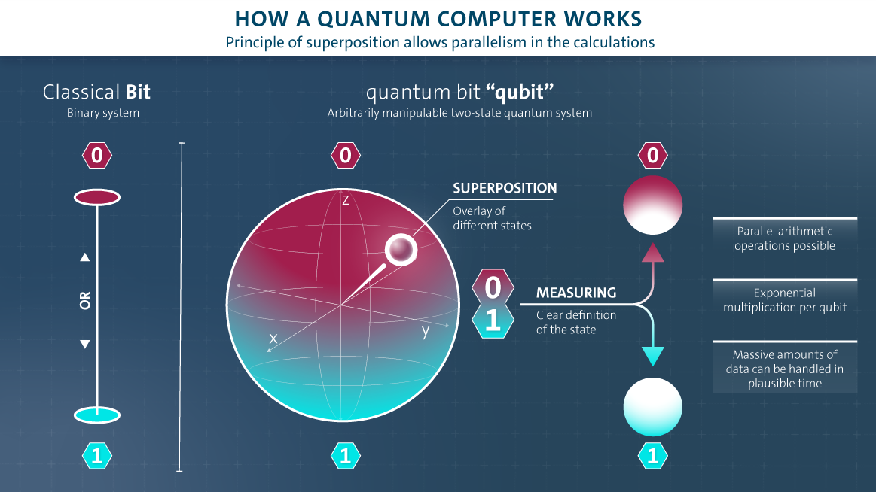
How do they work?
Here’s a link to a quantum computing interactive to learn more about how they work:
Quantum Playground

Slide 5
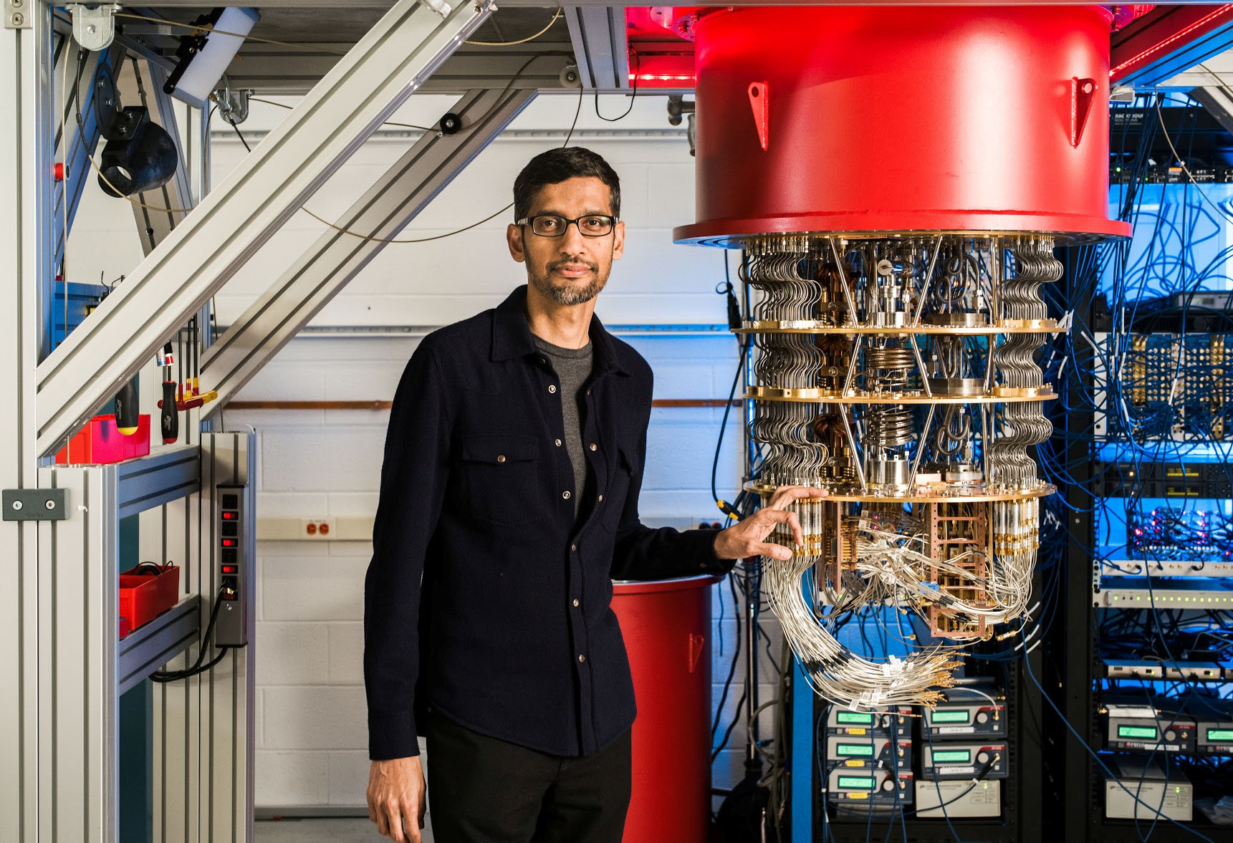
Plan and Implementation
Quantum computing can be used to improve various fields of research.
Notes:
Quantum computing has the potential to impact a wide range of fields and industries, due to its ability to perform certain types of computations exponentially faster than classical computers.
A list of areas that could be affected include:
Cryptography: Quantum computers could potentially break many cryptographic algorithms that currently secure our online communications.
Materials science: Quantum computers could be used to simulate the behavior of atoms and molecules, which could lead to the discovery of new materials with novel properties.
Drug discovery: Quantum computers could be used to simulate the behavior of complex biological systems, which could accelerate the discovery of new drugs.
Optimization problems: Quantum computers could be used to solve certain types of optimization problems that are intractable for classical computers, which could have applications in fields such as logistics and supply chain management.
Machine learning: Quantum computers could potentially be used to speed up certain types of machine learning algorithms, which could have applications in areas such as natural language processing and image recognition.

Slide 6
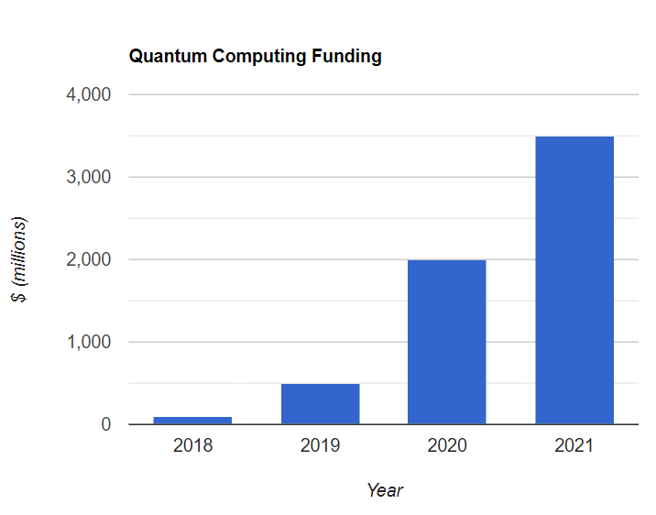
Investment
Quantum computing is proving to be valuable - enough so that millions of dollars are being spent in innovation and research into this technology.
See this article from Forbes for more info

Slide 7
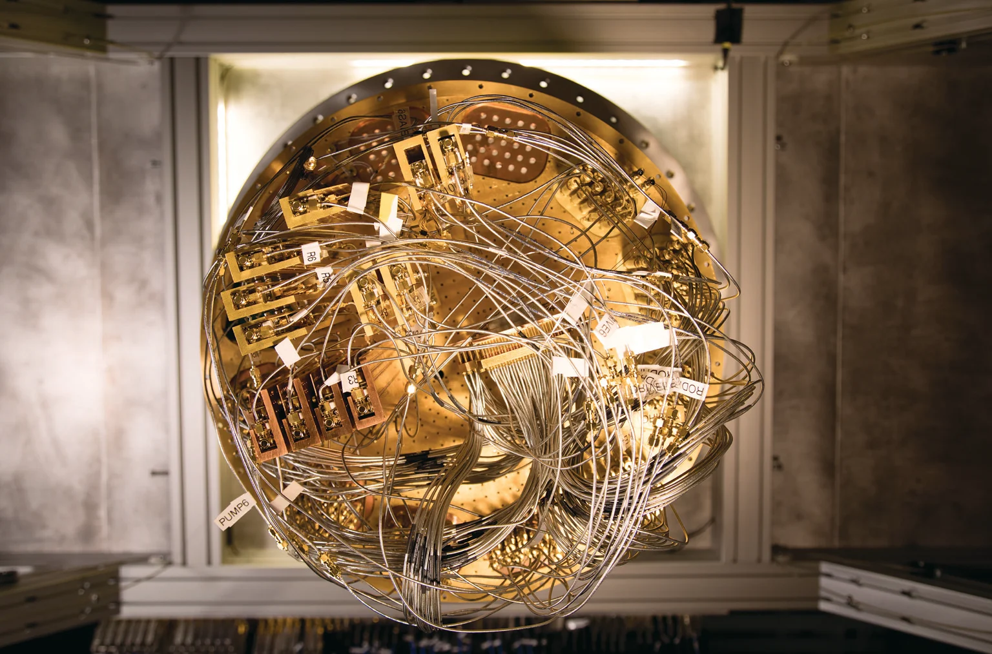
Upsides/Pros to Quantum Computing
Faster Calculations
Simulate behaviour of complex systems
Parallel Processing
See this video and article for some potential uses of quantum computing:
Article - Future Quantum Computing Uses
Video - Future Quantum Computing Uses
Notes:
There are a number of technical challenges in building a large-scale quantum computer. Physicist David DiVincenzo has listed these requirements for a practical quantum computer:
Physically scalable to increase the number of qubits
Qubits that can be initialized to arbitrary values
Quantum gates that are faster than decoherence time
Universal gate set
Qubits that can be read easily
Sourcing parts for quantum computers is also very difficult. Superconducting quantum computers, like those constructed by Google and IBM, need helium-3, a nuclear research byproduct, and special superconducting cables made only by the Japanese company Coax Co.
The control of multi-qubit systems requires the generation and coordination of a large number of electrical signals with tight and deterministic timing resolution. This has led to the development of quantum controllers which enable interfacing with the qubits. Scaling these systems to support a growing number of qubits is an additional challenge.
Expansion on Pros:
Quantum computers have the potential to perform certain calculations much faster than classical computers, which could lead to significant breakthroughs in areas such as cryptography, drug discovery, and optimization problems.
Quantum computers have the ability to solve problems that are currently intractable with classical computing methods, such as simulating large molecules or predicting the behavior of complex systems.
Quantum computers use quantum bits (qubits) that can exist in multiple states simultaneously, allowing for parallel processing and exponentially increasing computational power.

Slide 8
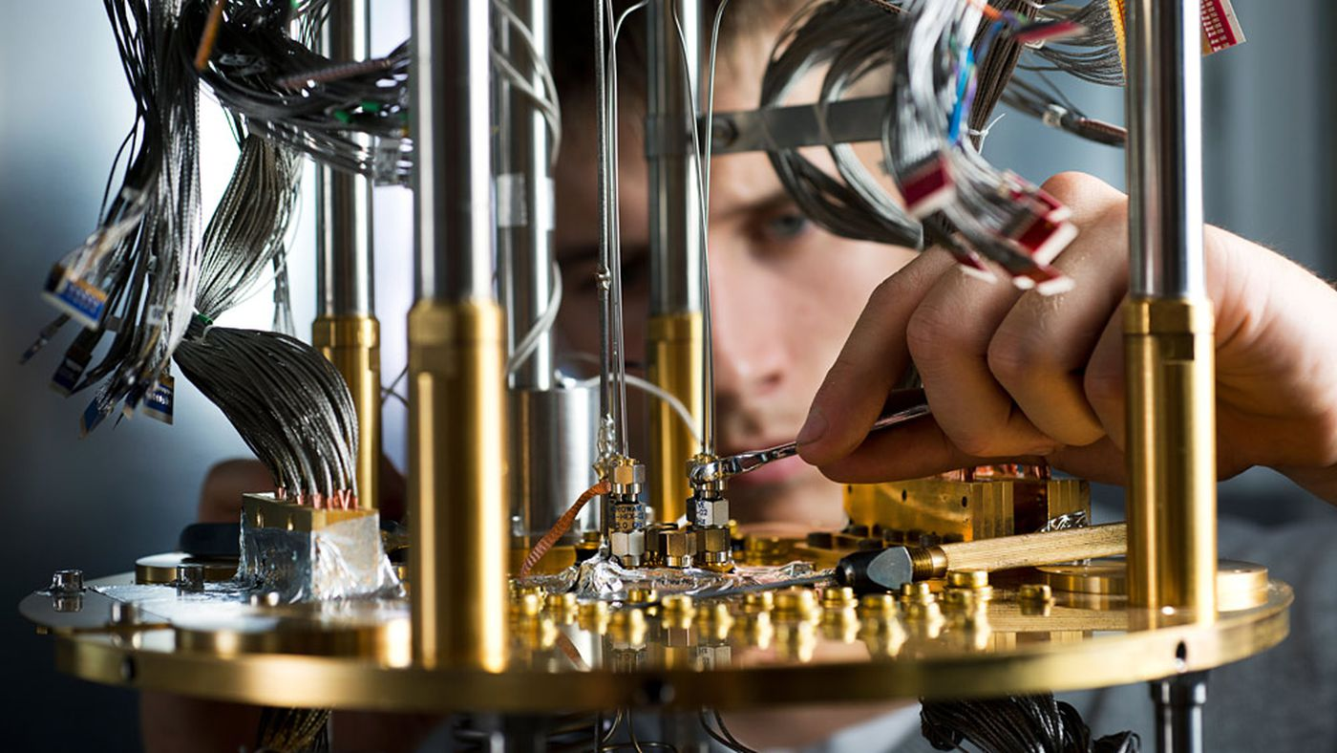
Downsides/Cons to Quantum Computing
Fragile
Prone to Error
Limited Applicability
Complex
Notes:
Fragility: Quantum computers are highly sensitive to their environment and can be easily disrupted by external factors such as temperature fluctuations, electromagnetic fields, and vibration. This makes them difficult to operate and maintain.
Error-prone: Quantum computers are inherently error-prone due to the phenomenon of quantum decoherence, which can cause errors to accumulate in calculations over time. This means that quantum algorithms must be designed to be fault-tolerant, which can be a difficult and computationally expensive task.
Limited applicability: While quantum computers are well-suited for certain types of calculations such as quantum simulation and optimization, they are not necessarily faster than classical computers for all types of computations. This means that the potential benefits of quantum computing may be limited to specific applications.
Complexity: Quantum computing is a highly complex and specialized field that requires expertise in areas such as quantum mechanics, computer science, and engineering. This means that the development and operation of quantum computers may be more difficult and costly than for classical computers.
The rapid progression of quantum computing could lead to disruption of entire industries as it could render many current technologies useless. On top of that, it could be turned into something of an arms race between nations as they attempt to develop quantum computers for their uses in cryptography.

Slide 9
Summary
Quantum computing has much potential to completely change the way technology works in our current world. It can allow for incredible advancements that would never be possible with our current computers, but is also comes with many downsides that we should be wary of as it is further developed.
I believe that quantum computing is an incredibly important next step for the development of human technology, but from what I’ve learned today I think it is something we should lay off making available to the public until we have a way to safely use it.

Slide 10
References
https://www.britannica.com/technology/quantum-computer
https://www.hpcwire.com/2019/01/10/ibm-quantum-update-q-system-one-launch-new-collaborators-and-qc-center-plans/
https://dl.acm.org/doi/10.1145/2830570
https://royalsocietypublishing.org/doi/10.1098/rspa.1985.0070
https://www.quantumplayground.net/#/home

